Slide 1
Why we should study the media
"We are drowning in information but starved for knowledge."
--John Naisbitt, Megatrends

Slide 2



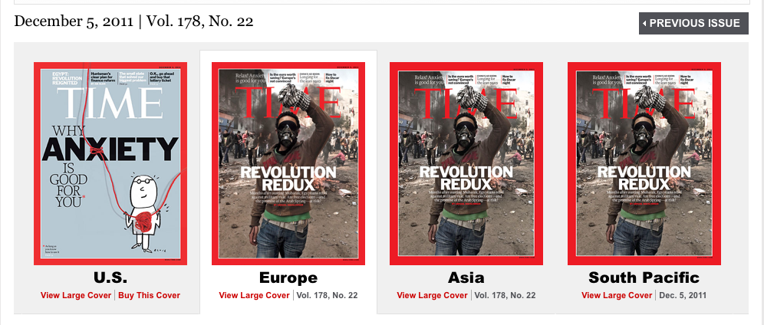
Media use can exceed 24 hours a day
Social Media Facts
Endorsements
Magazine readership
Facts about TV News
You know you want to sign up!

Slide 3
What is Media Literacy?
A repertoire of competencies that enable people to evaluate, analyze, and create a variety of media modes, genres, and formats
Encourages people to ask questions about what they watch, hear, and read
It’s about developing young people’s critical and creative abilities when it comes to the media
Media
Literacy sounds amazing!

Slide 4
Media Literacy at Freedom HS
Sign up!
5 Unit Semester Course for grades 11-12
In this course, students will:
  Analyze and evaluate a variety of media modes (social, commercial, entertainment, personal, etc.)
  Read passages of Media Literacy textbook in class and articles in class/at home
  Write informative/argumentative texts
  Participate in small group/whole class discussions
  Debate
  Give presentations using Powerpoint , video, etc.
Communications Academy Capstone class
  Passing Media Literacy fulfills one of the final requirements you need to be considered a graduate of the Communications Academy

